Slide 1
SEGMENT‑UI: Improving LLM Design‑to‑Code via Image Segmentation
Michael Norman
M.S. Computer Science Student
M.S. Thesis Defense – May 9th, 2025

Slide 2
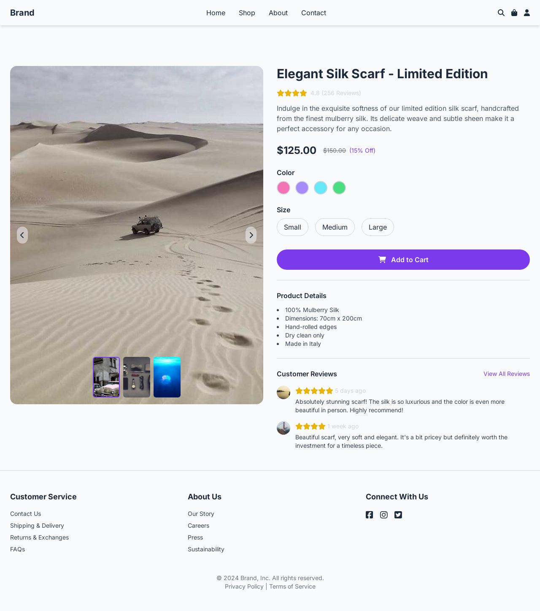
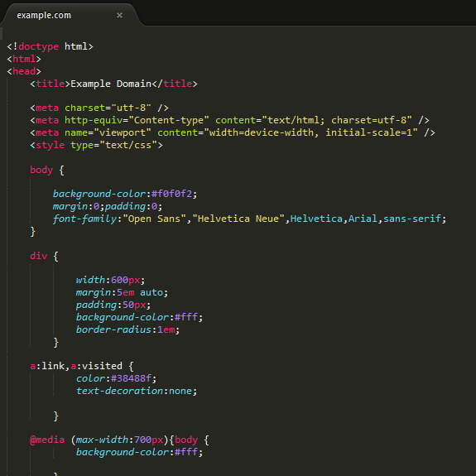
What is Design-to-Code?
Introduction

Slide 3
What is Design-to-Code?
Introduction
Converts a static User Interface (UI) image into runnable HTML code
Mirrors dev workflow
Designer designs page and developer re‑implements in code
Goal is to reduce manual translation time & human error

Slide 4

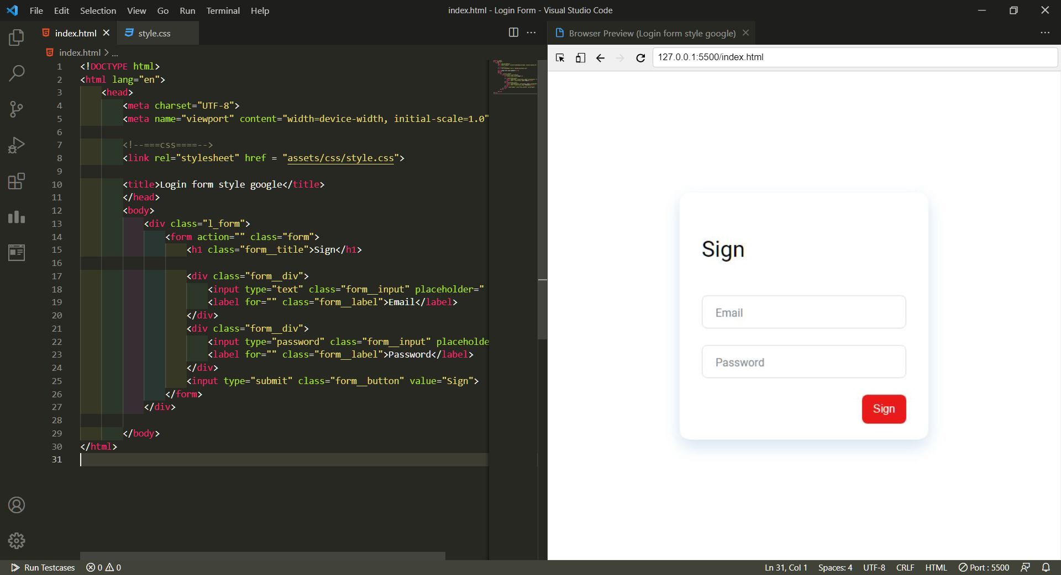


Design‑to‑Code Workflow
Introduction
Designer creates design in software (Figma)
Design sent to Developer
Developer manually creates layout, styling, and page content
Iterative refinement back‑and‑forth between teams
Just 1 small change
Ok, fine

Slide 5


Design-to-Code Challenges
Introduction
Slow, manual, and repetitive process
Median time coding simple enterprise page is 4.2 hours^{[1]}
Requires front-end developer expertise
Active cross-team communication
Teams spend up to 50% of their time re-doing work due to poor communication^{[2]}

Slide 6
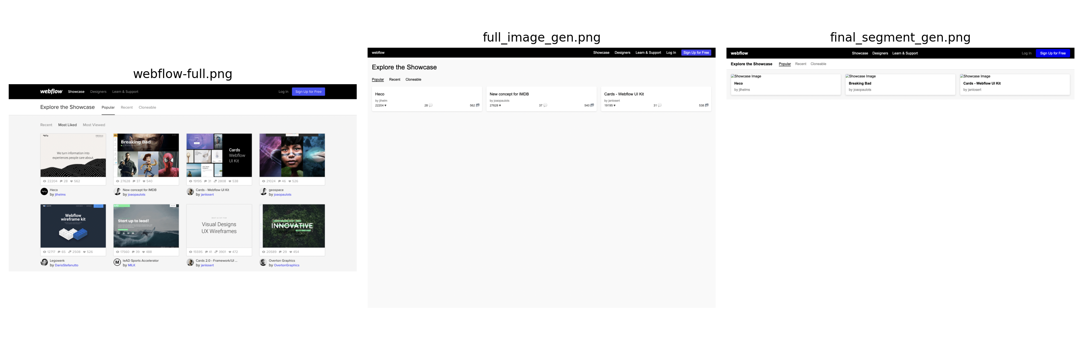



Why Can’t We Just Prompt ChatGPT?
Introduction
When given a full-page screenshot, LLMs omit elements, distort layouts, or misplace content
Multimodal LLMs struggle with fine details in images
A study^{[3]} reports that GPT-4 correctly reproduced only 40 out of 1,699 UI elements from full-page screenshots (2.4%!!!)
???

Slide 7
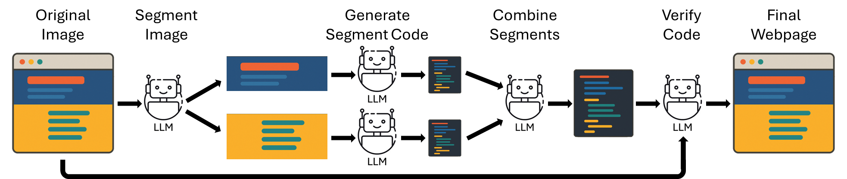
This Thesis Proposes SEGMENT‑UI
Introduction
Goal:
Increase completeness & usability
Idea:
Break image into logical segments based on UI components
Iterative prompting workflow

Slide 8
Research Questions
Introduction
RQ1: Does image segmentation and iterative prompting lead to more accurate code?
RQ2: Which segmentation method offers the highest accuracy compared to the original image?
RQ3: How do human developers judge the usability of the generated code compared to an LLM’s quantitative accuracy score?

Slide 9
Background

Slide 10
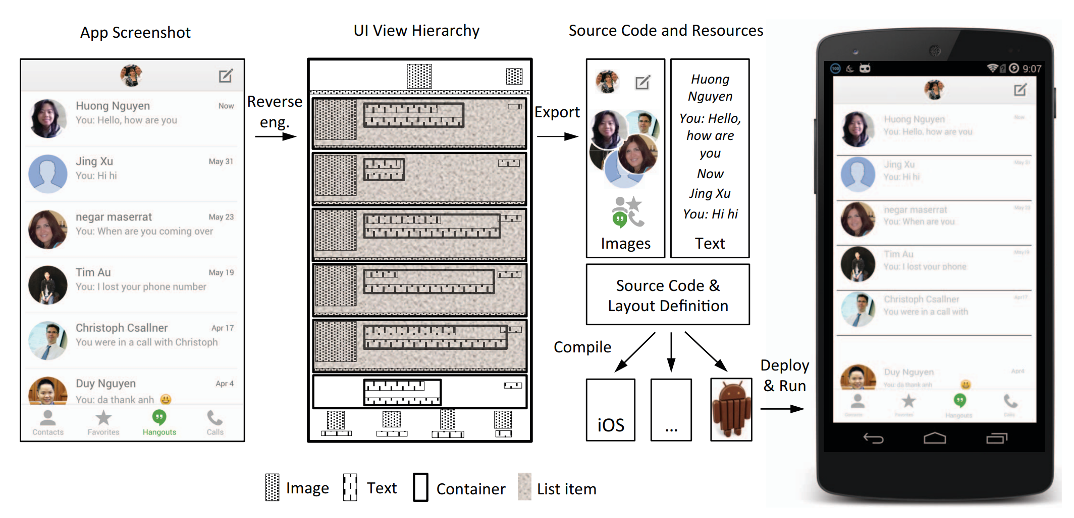
Rule-based Era
Background
REMAUI^{[4]} (2015)
First end-to-end bitmap to Android code pipeline for mobile UIs
Combines Computer Vision and OCR for element detection
Heuristic rules infer UI hierarchy
Outputs Android XML and Java

Slide 11
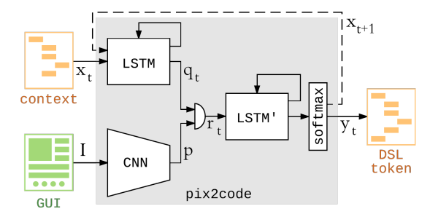
Deep Learning Era
Background
pix2code^{[5]} (2017)
First deep learning GUI to code model
Combines an encoder (CNN) + decoder (LSTM) model trained end-to-end to generate Domain Specific Language (DSL) tokens from screenshots
Achieves ≥77 % code accuracy across simple GUI dataset

Slide 12

Multimodal LLM Era
Background
Multimodal LLMs allow multiple types of input such as images and text
Achieve near human-level performance in tasks such as Visual Question Answering (VQA)^{[6]}
Can analyze input images, describing visuals and interpreting diagrams
Text
Input
Output
Text
Image

Slide 13
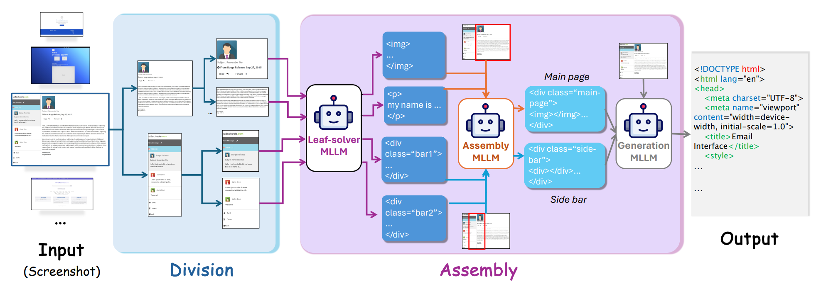
Multimodal LLM Era
Background
DCGen^{[7]} (2024)
Introduces a divide-and-conquer framework using a multimodal LLM
Semantic segmentation splits page by recursively making horizontal or vertical slices
Segments are fed into multimodal LLM prompt to produce HTML snippets which are reassembled into a final layout

Slide 14
Methods

Slide 15
Intuition
Methods
Multimodal LLMs become overwhelmed with large images
We can break up images into smaller chunks to pick up details
Humans work in the same way by focusing on one section at a time
SEGMENT-UI copies that workflow
General outline
Focus on one segment at a time
Merge segments together
Self-check for accuracy

Slide 16
SEGMENT-UI Workflow
Methods

Slide 17

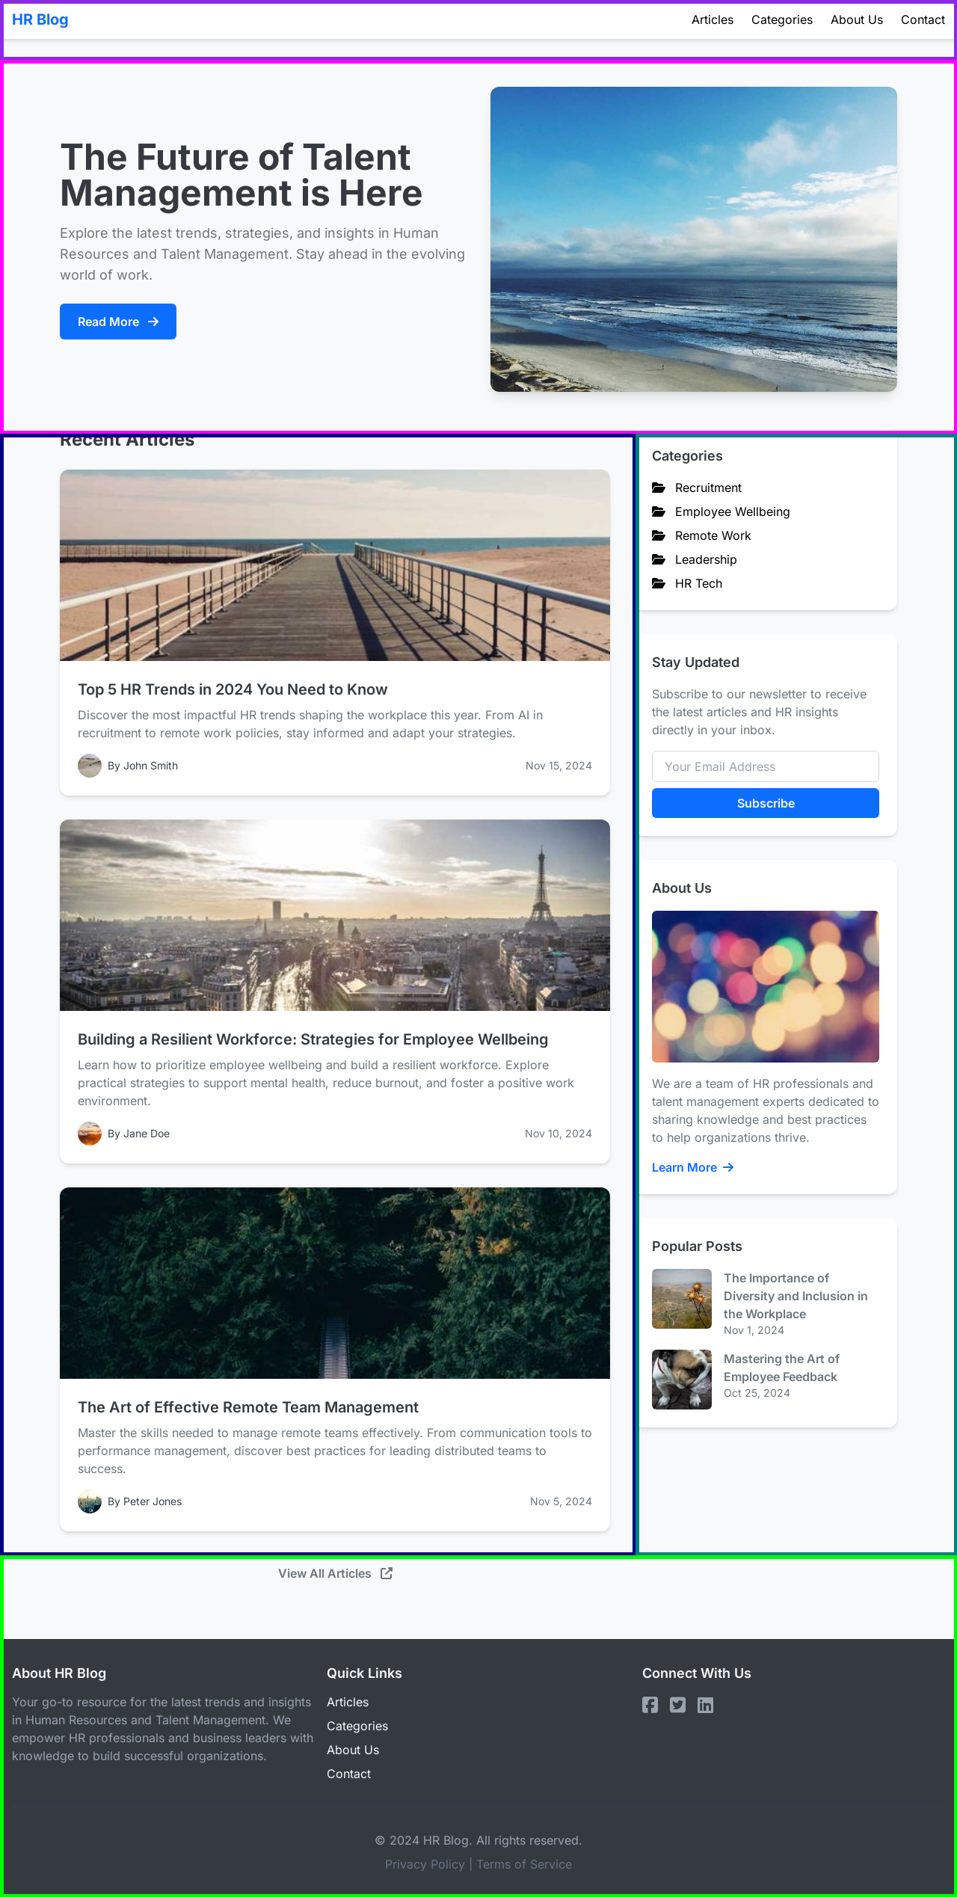
SEGMENT-UI Workflow
Methods
Step 1: Segment Image
Prompt LLM with original image to identify the major UI components with pixel bounding boxes

Slide 18

SEGMENT-UI Workflow
Methods
Step 2: Generate Layout Skeleton Code
Create a masked image with generated bounding boxes
Prompt LLM to generate a skeleton base structure of HTML code
Base Structure
Mask Image

Slide 19

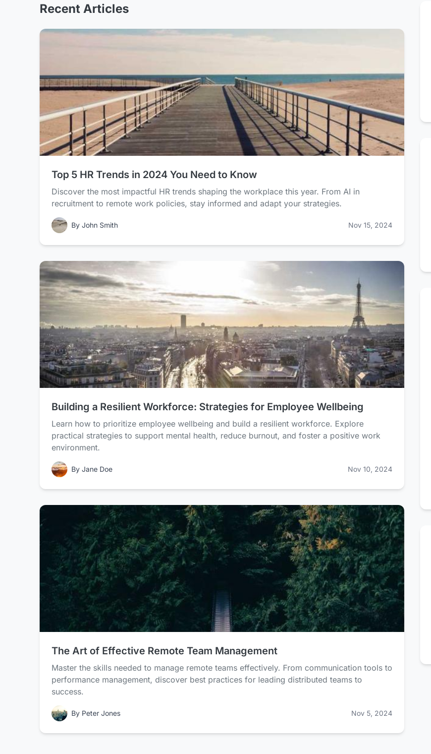

SEGMENT-UI Workflow
Methods
Step 3: Generate Each Segment Code
Prompt LLM to generate code for each segment individually
Image Segments
Segment Code

Slide 20
SEGMENT-UI Workflow
Methods
Step 4: Combine Segment Code
Prompt LLM with code from each segment and base structure
Base Structure
Segment Code
Preview Code

Slide 21
SEGMENT-UI Workflow
Methods
Step 5: Verify Code
Render code into screenshot and prompt LLM with current code and original image
Final Code
Preview Code
Screenshot

Slide 22


Naïve Image Segmentation Comparison
Methods
Fixed-Size Segments
50px tall segment for presumed navbar
500px tall segments until end of image
Overlapping Segments
1000px tall segments with 50% overlap
LLM-Defined
Fixed-Size
Overlapping
Notes:
We Compare LLM segmentation against 2 naïve methods

Slide 23
Zero-Shot Baseline
Methods
We compare segmentation methods against a simple baseline
Full screenshot sent to LLM in single prompt
No image segmentation, iterative prompting, or self-verification
Original Image
Final Code
Notes:
We Compare LLM segmentation against 2 naïve methods

Slide 24


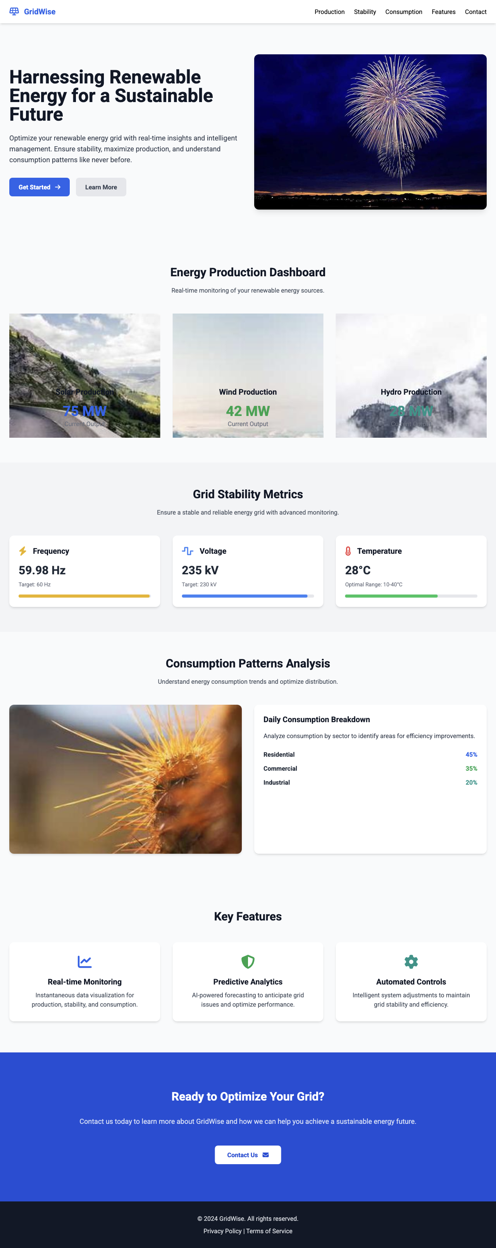
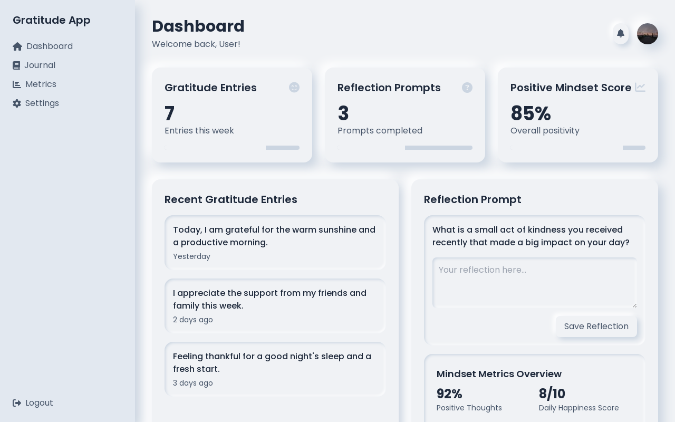
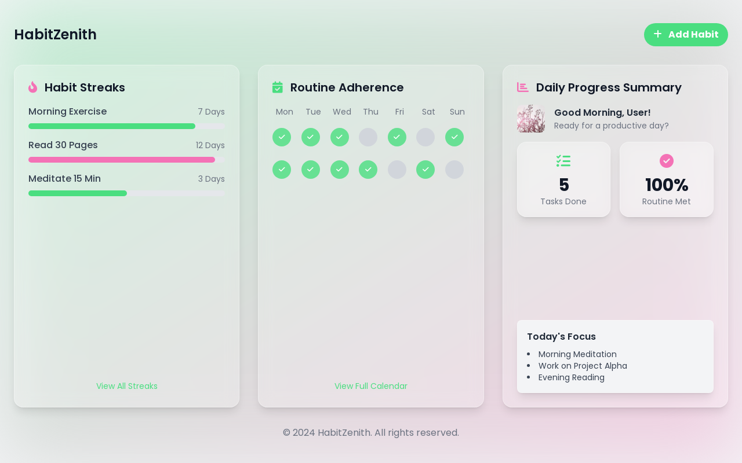
Dataset
Methods
12 diverse webpages selected from public UI Reasoning Dataset
Variety of pages including dashboards, blogs, e‑commerce
Variety of aspect ratios and level of detail

Slide 25
Human Evaluation
Methods
8 participants with web development experience
Given 12 generated images to compare against original image
Blind comparison of four methods:
Zero-Shot Baseline
LLM-Defined Segments
Fixed-Size Segments
Overlapping Segments

Slide 26
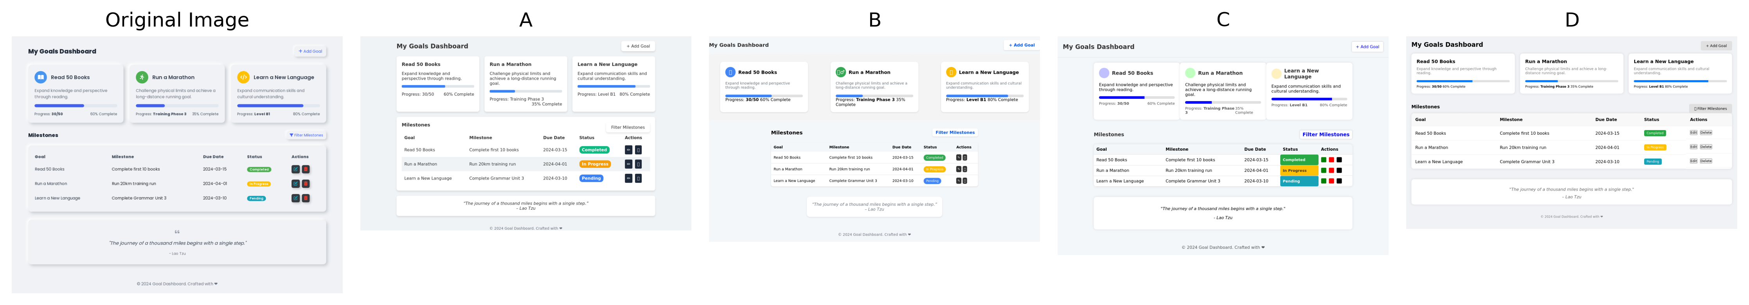
Human Evaluation - Ranking
Methods
Asked to rank images 1-4 on similarity to original image
Lower rank = better (1 is best)
Emphasizing the usability as a starting point for web development
Zero-Shot
LLM-Defined
Fixed-Size
Overlapping

Slide 27
Human Evaluation - Acceptability
Methods
Asked to individually rate as either “Acceptable” or “Unacceptable”
Emphasizing the usability as a starting point for web development
Zero-Shot
LLM-Defined
Fixed-Size
Overlapping

Slide 28
LLM Evaluation
Methods
Prompted GPT-4o with original image and rendered HTML image
Graded on Structure, Content, Expected Functionality, and Overall
Rated 0-100, Higher = better
Generated
Original
{ Visual: 90, Content: 80, Functionality: 70, Overall: 80 }

Slide 29
Results

Slide 30
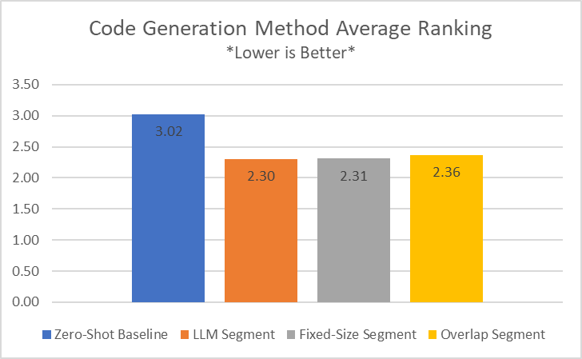
Human Evaluation - Ranking
Results
All three segmentation methods beat baseline in ranking task
No significant gap among the three segmentation methods
23% average improvement over baseline

Slide 31
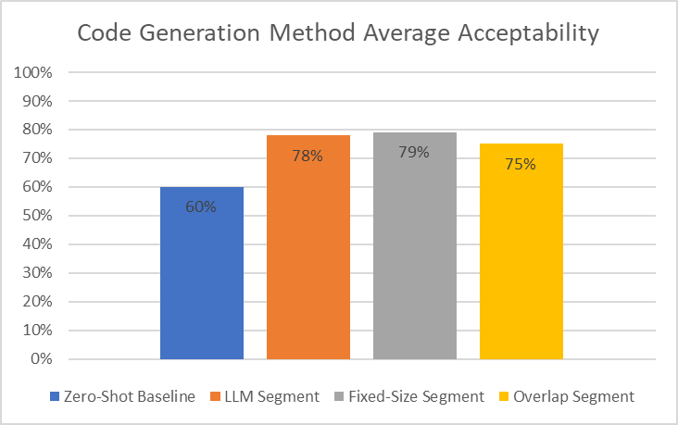
Human Evaluation - Acceptability
Results
Again, all three methods beat baseline significantly
And again, no significant gap between methods
29% average increase in acceptability over baseline

Slide 32
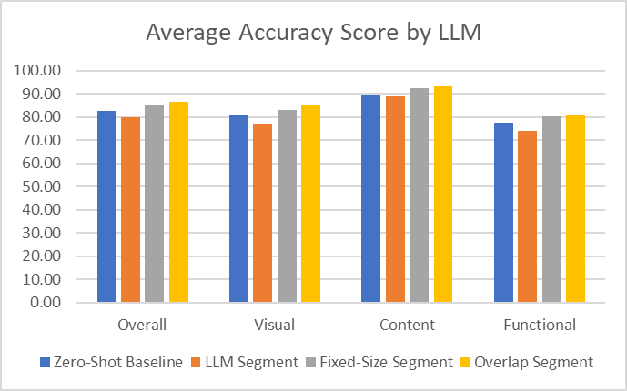
LLM Evaluation
Results
All methods fall into a similar, narrow range across metrics
Minimal variation among different methods
Clear difference from human evaluation

Slide 33
Key Findings

Slide 34


Segmentation Quality vs. Code Quality
Key Findings
Original Image with Bounding Boxes
Success Cases:
Correct two-column layout
Text content and alignment
General page structure
Generated Image

Slide 35

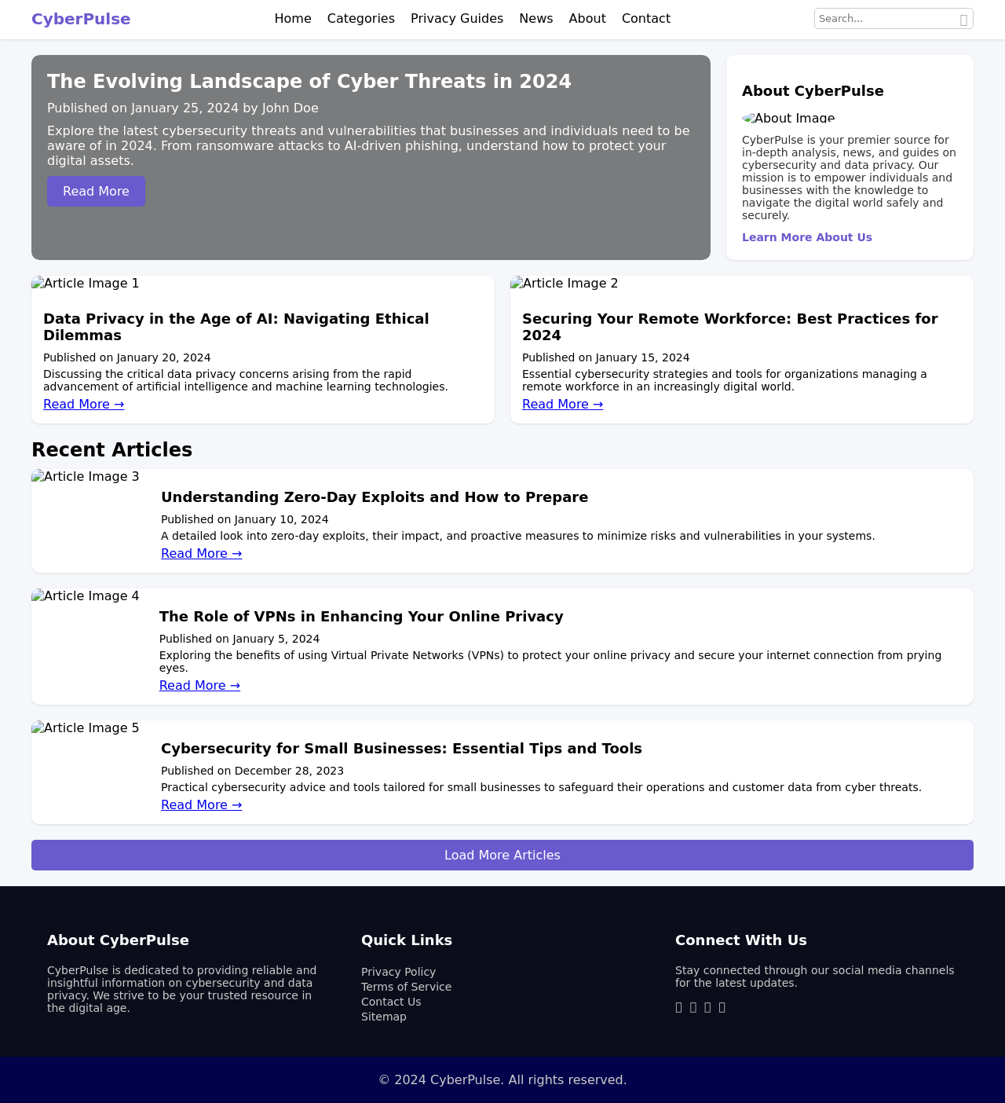
Segmentation Quality vs. Code Quality
Key Findings
Failure Cases:
Segments cut through components
Incorrect page structure
Missing content
Can duplicate content
Original Image with Bounding Boxes
Generated Image

Slide 36
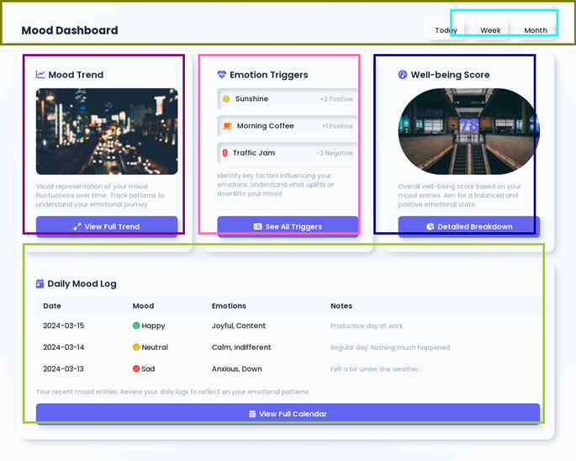
LLMs as Image Segmenters
Key Findings
Success Cases:
LLM identifies major components
Bounding boxes roughly align to content
Handles complex layouts

Slide 37
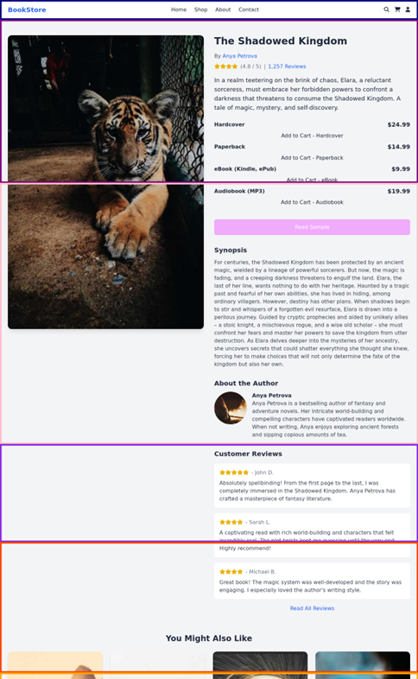
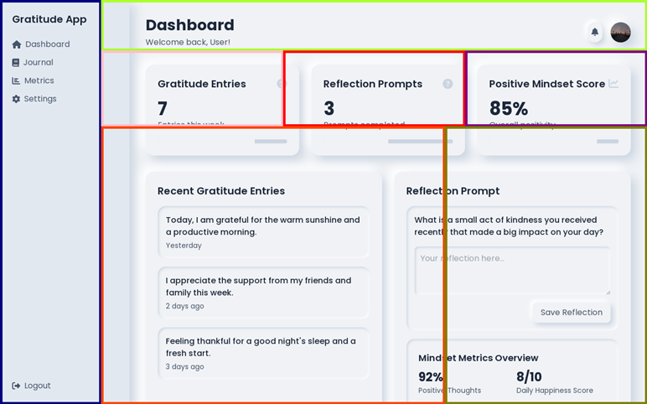
LLMs as Image Segmenters
Key Findings
Failure Cases:
Misaligned segment boundaries
Cut off content
Disregards page structure

Slide 38
Comparing Image Segmentation Methods
Key Findings
All methods significantly outperform baseline
Very minor differences, but practical trade-offs
LLM-Defined
+ Smaller segments, handles odd shapes
– Slow, tends to overshoot
Fixed-Size
+ Fast
– Can easily cut off components
Overlapping
+ Fast, ensures coverage
– Doubled token cost, can duplicate page elements

Slide 39
Comparing Image Segmentation Methods
Key Findings
The iterative prompting workflow is much more important than the specific segmentation method
The LLM can recover nearly the same amount of detail regardless of method

Slide 40
Latency Considerations
Key Findings
Segmentation workflow causes 727% latency increase
0.9 to 7.2 mins!!!
Fine for offline generation, very slow for live prototyping
Could be improved with parallel API calls, but can harm accuracy

Slide 41
Human vs. LLM Evaluation
Key Findings
LLMs cannot be trusted with fine details from images
Humans still needed for multimodal evaluation
LLMs reports equivalent performance or even some loss
Humans find clear improvement over baseline

Slide 42
Future Work

Slide 43
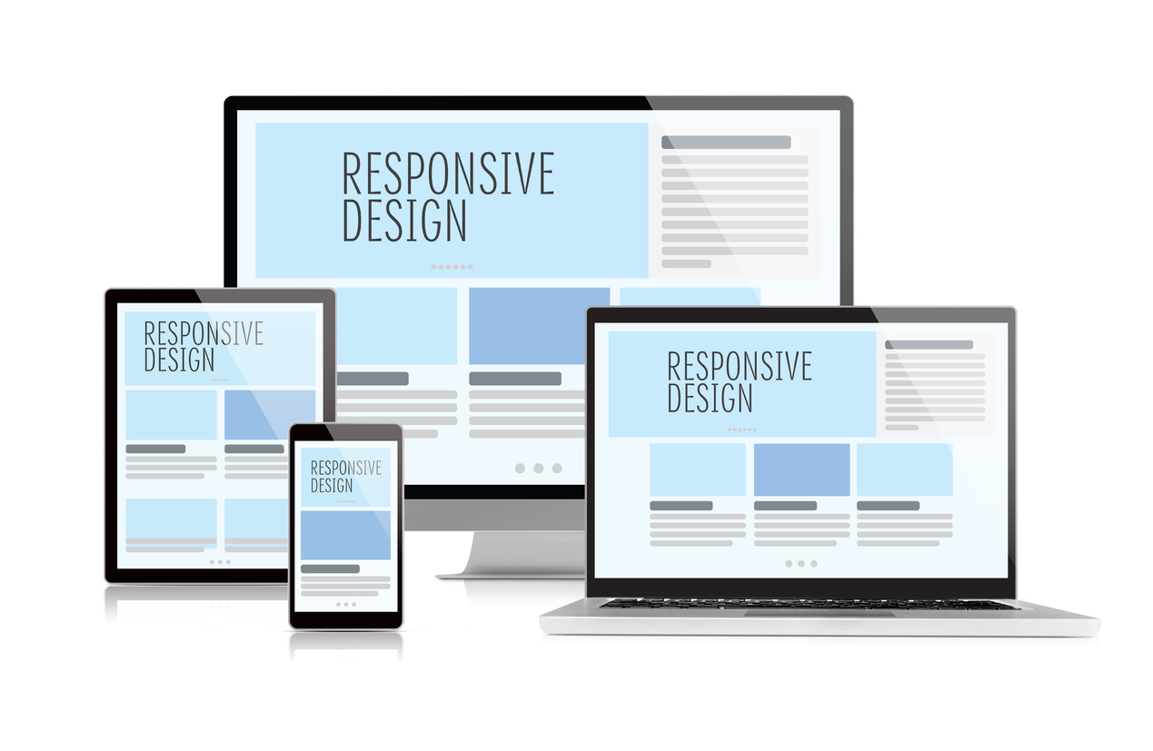
Responsive Designs
Future Work
Modern applications demand responsive content sizing
Extend prompt pipeline to include images with multiple screen sizes
Evaluate generated code at different screen sizes

Slide 44

Expanded Human Evaluation
Future Work
Recruit more participants from variety of backgrounds and experience
Students, early career, experts
Test ease of integration, readability, time to adapt for production

Slide 45



LLM Model Diversity
Future Work
Repeat tests with other LLMs like Claude 3.5 Sonnet, Gemini 2.5 Pro, and Llama 4
Compare token cost, speed, and component accuracy

Slide 46
References
[1] Sparkbox & IBM Carbon Design System, “Developer efficiency and design-system value: Measuring the business impact of a design system,” Sparkbox white paper, 2023.
[2] N. Hopkins, “Design specifications — speeding up the design-to-development workflow and improving productivity,” Adobe Blog, 21 Nov 2017.
[3] Y. Wan, C. Wang, Y. Dong, W. Wang, S. Li, Y. Huo, and M. R. Lyu, “Automatically gen-erating ui code from screenshot: A divide-and-
conquer-based approach,” arXiv preprint arXiv:2406.16386, 2024.
[4] T. A. Nguyen and C. Csallner, “Reverse engineering mobile application user interfaces with remaui (t),” in 2015 30th IEEE/ACM International Conference on Automated Software Engineering (ASE), pp. 248–259, 2015.
[5] T. Beltramelli, “pix2code: Generating code from a graphical user interface screenshot,” 2017.
[6] OpenAI, “GPT-4.” https://openai.com/index/gpt-4-research/, 2025.
[7] Y. Wan, C. Wang, Y. Dong, W. Wang, S. Li, Y. Huo, and M. R. Lyu, “Automatically generating ui code from screenshot: A divide-and- conquer-based approach,” arXiv preprint arXiv:2406.16386, 2024.

Slide 48
Q&A

